Slide 1
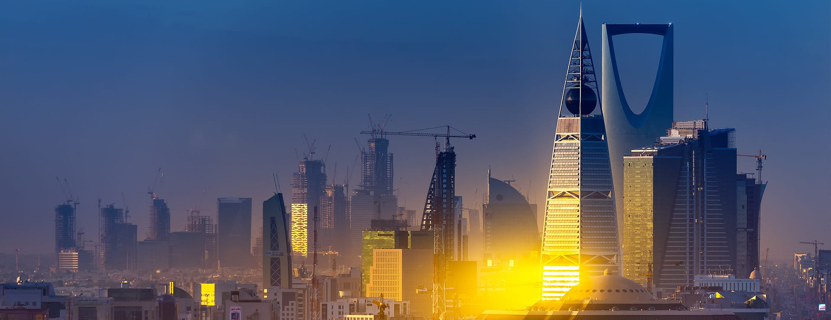
Where to build a movie theater in Riyadh

Slide 2

Figure out where people mostly hang out

Slide 3
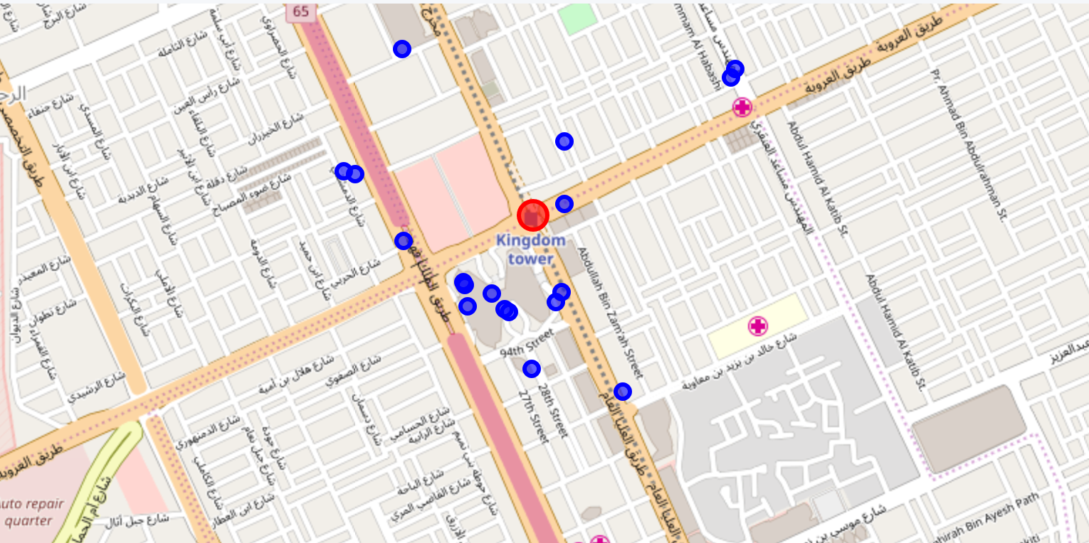
Center of Riyadh

Slide 4
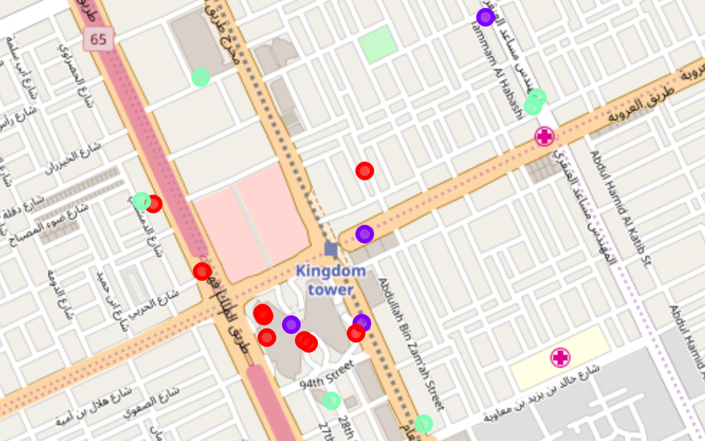
Top rated restaurants

Slide 5
Conclusion
Apparently most preferred area is the center of the map with the

